Slide 1
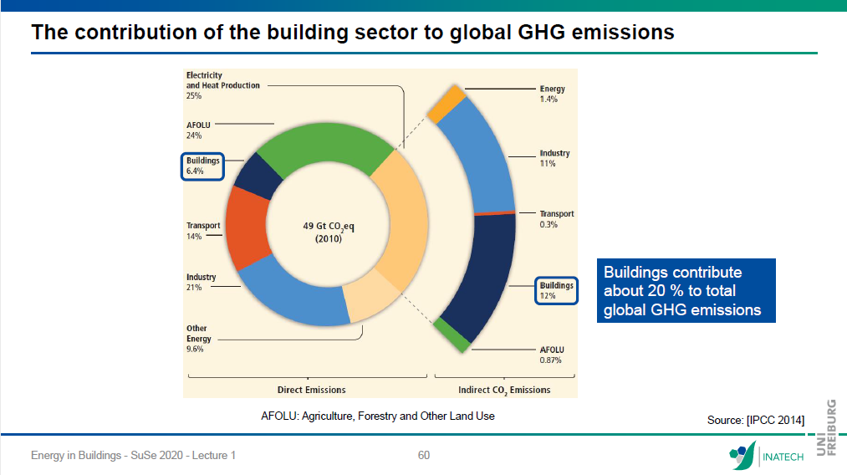
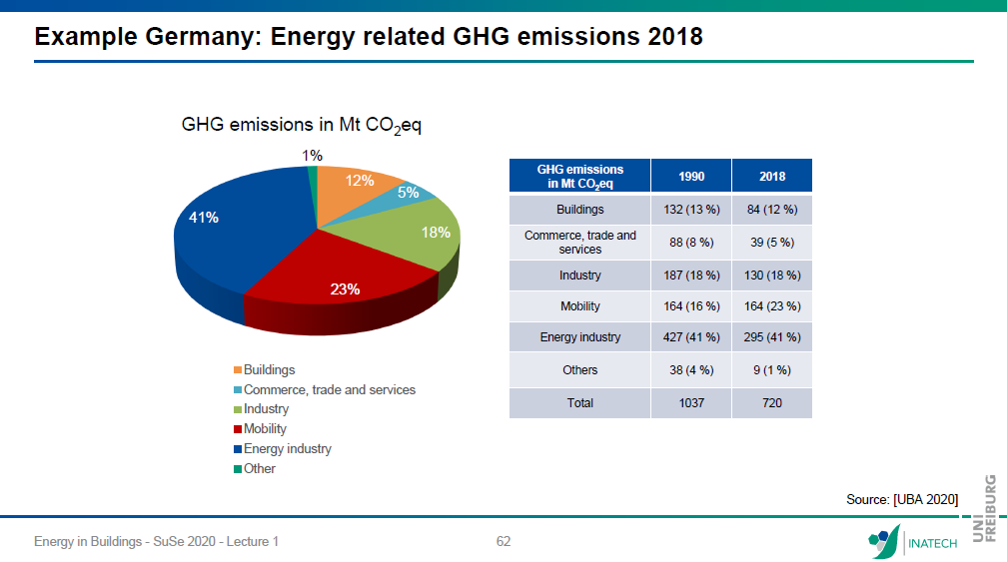
CO₂ emissions by sector
menti.com/4u3285jgöes5t
Notes:
You know this chart
Maybe you‘ve heard about the german climate goals
have been meet for all sectors except for the building sector
Building sector consists of public and privat building
well hae a look at the privat sector for now
Which again consists of Space heating, dhw, and electricity.
This probably hasent been new for you, because you have heard about it in every second lecture
But do you know about your own co2 emissions for meeting your thermal comfort
We have set up a little questionary on menti

Slide 2
menti
What kind of heat source do you have in your building?
- oil-boiler, gas-boiler, electric heating, heat pump, district heating, wood, i don‘t know
Guess, how much energy / CO₂ is needed / emitted to meet your thermal comfort in one year?
Energy: _________ kWh/a
CO₂: _________ t/a
* I have no clue!?

Slide 3
What kind of heat source do you have in your building?
Guess, how much CO₂ is emitted to meet your thermal comfort in one year?
Barchart with averages for continents, and co2 budget p.p./a
[Volker Quaschning]
Average 2021
(5 t/a)
Annual CO2 budget per person until 2050 to meet the 1.5 °C goal (0.17 t/a)
[https://ourworldindata.org/co2-emissions] data for 2017
[https://www.unika-kalksandstein.de/downloads-unika/category/19-waermeschutz.html?download=109:geg-2020]
Notes:
Discuss menti results and show averages.
As you see there is a lot potetial to save co2 emissions in the building sector. And we are all involved, since we all live in a buildings that needs be heated.
Data sources:
CO2 budget worldwide to meet 1.5 °C goal with medium probability: 460 Gt
[Volker Quaschning, Berliner Energietage, https://www.waermepumpe.de/fileadmin/user_upload/waermepumpe/05_Presse/01_Pressemitteilungen/Energietage_BWP_Quaschning-2021.pdf]
World population: 8 Mrd
CO2 budget per person: 58 tons, until 2050: 1.9 t/a
2021: annual CO2 emissions: 40 Gt/a global → 5 t/a p.P.

Slide 4
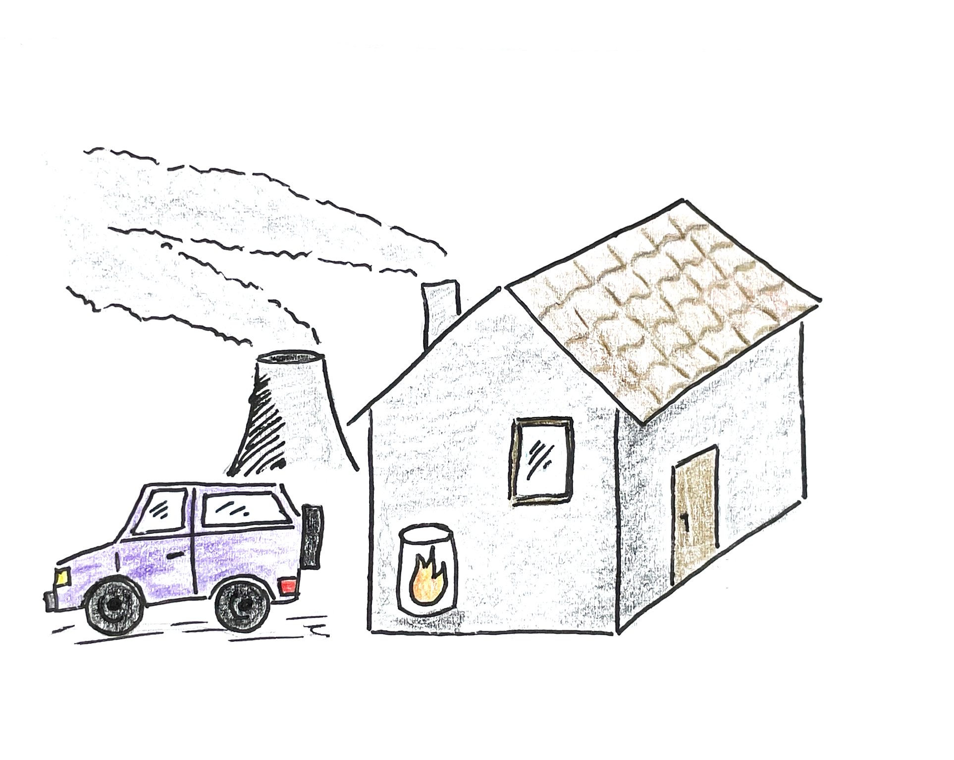
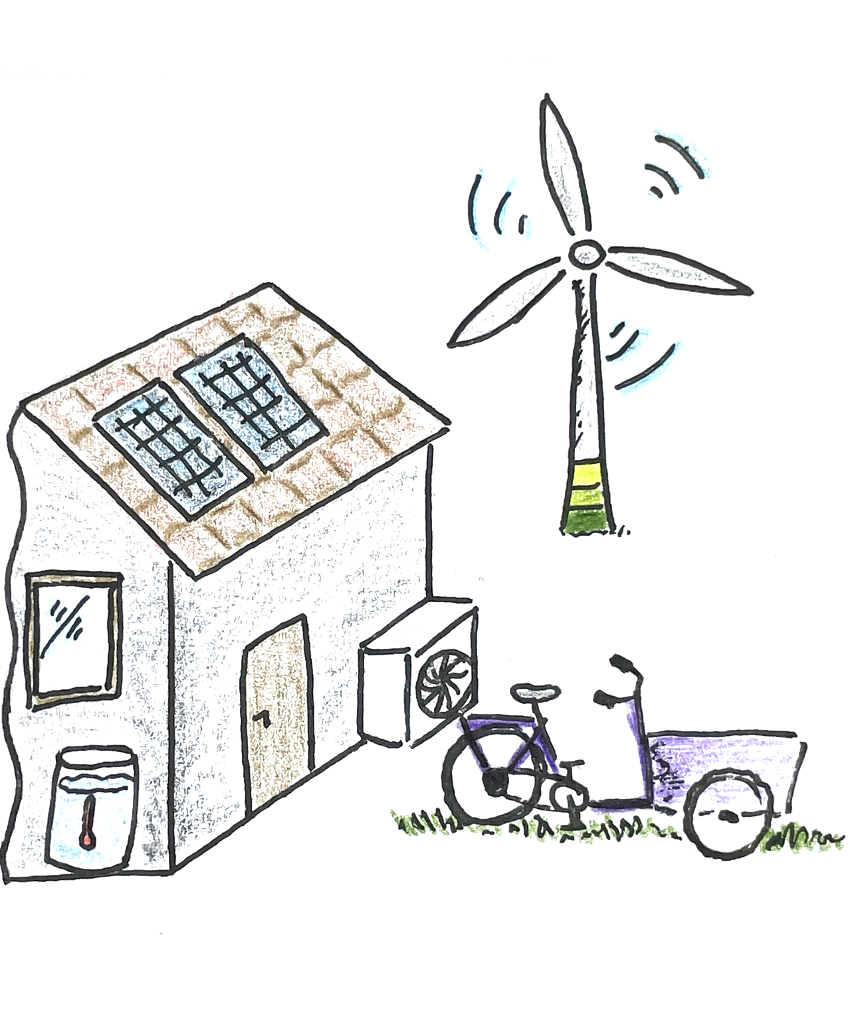
4. Reduce primary energy demand & CO₂ emissions
Improve heating technology
Supply demand with renewable energies
3. Reduce final energy demand
Renovation
Change of user behavior
2. Calculate energy demand
Final energy demand
Primary energy demand
CO₂ emissions
1. Asses current state
Building: location, geometry, materials
System: technology, efficiency, size
User habit: comfort temp., ventilation
Notes:
This is a sketch of the current state, as seen in the prev. Graphs.
What is needed to change the current situation?
Other than the chaning our user behaviour, most of us a not in the postion to reneovate their flat or order an alternative heating system.
But from our from our studies we gained lots of expertice in many of the supjects that are rlated to theses topics
So what we could do is spread our knowledge to the house owners or landlords.

Slide 5

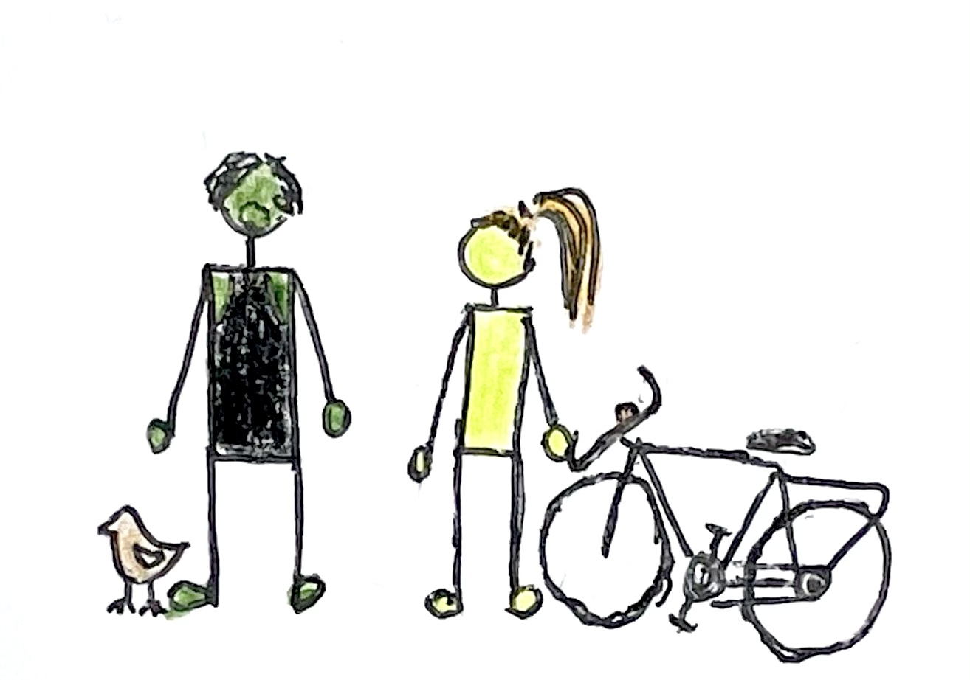
Simulation tool
Calculate current energy demand
Analyze refurbishment possibilities
Design energy supply system
Easy to acces
for free
online
open source
Experience & Teamwork
technical
social
Voluntary & Non Profit
- no hierachy
self-initiative
work at own pace
User Interface
self-explanatory
intuitv
no prerequists
educational gamification

Slide 6
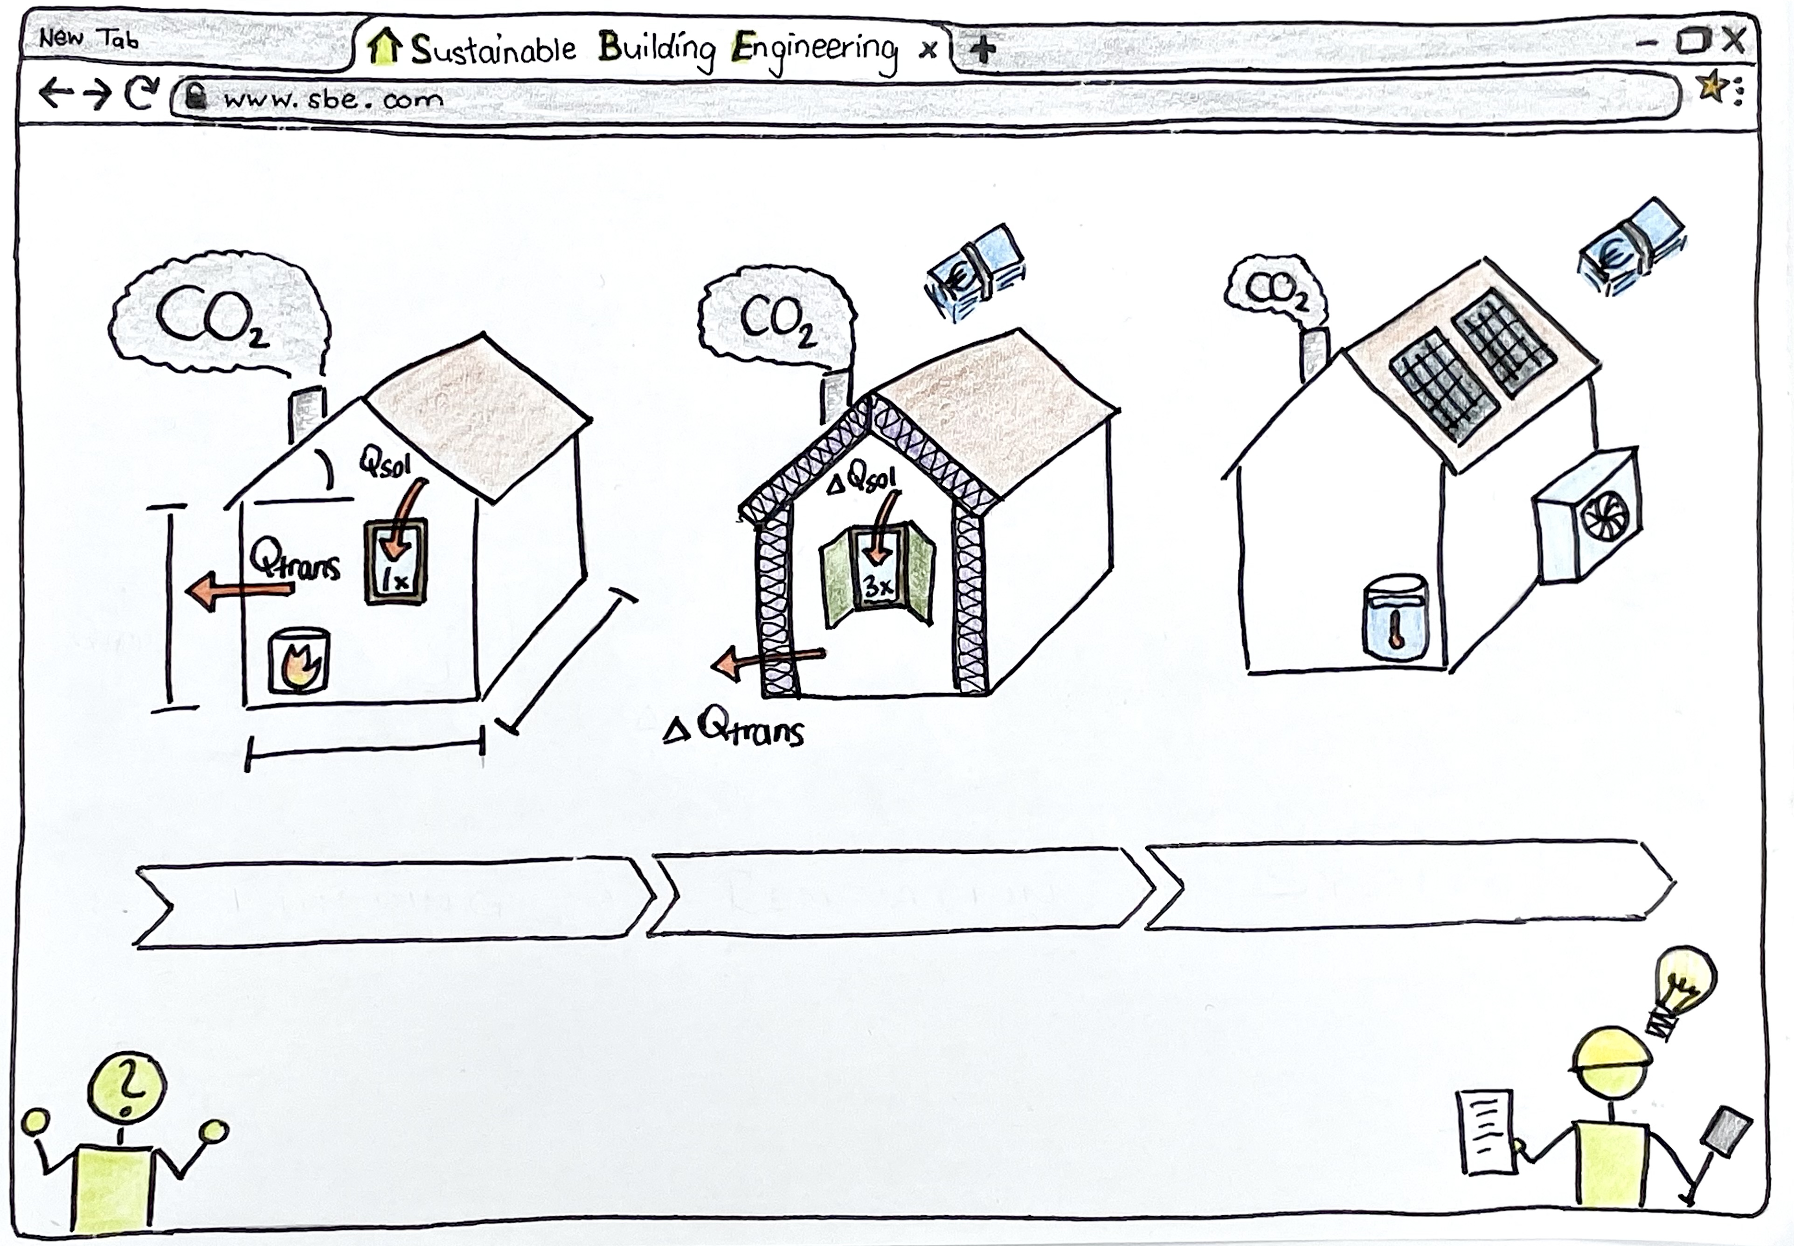
Building
Renovation
System

Slide 7



Implementation
???
Knowledge
Design
Try & Error
Teamwork
Awareness for CO₂ in Buildings
Web App
Research
Discussions
Coding
Python libraries
Time

Slide 8
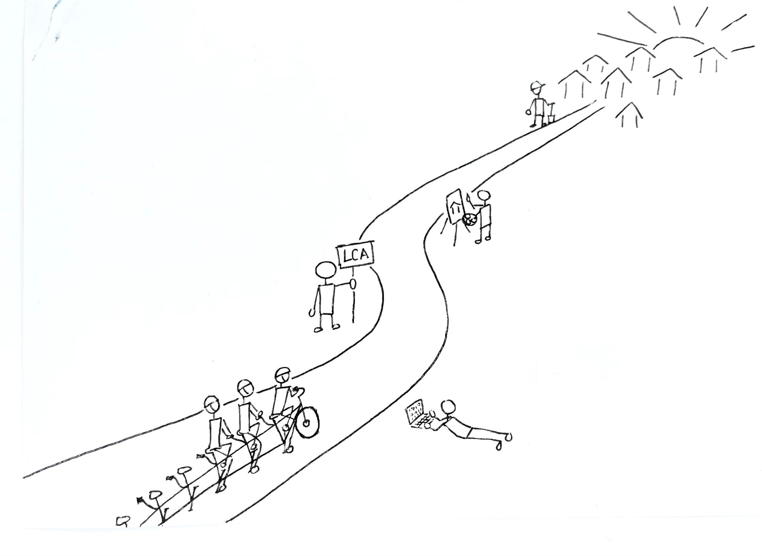
Thank’s for your attention !
Next online meeting:
Date: XX.XX.XXXX
Time: XX:XX o’clock

